Slide 1
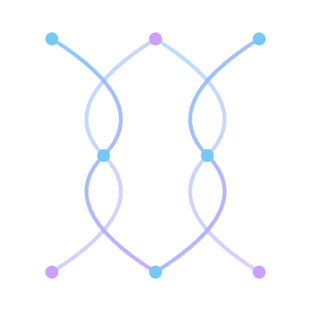
PROTEOSPHERE · A TOUR
A self-built ML platform for protein drug discovery.
Designed from the ground up so the answers it produces can be trusted — not just look good on a leaderboard.
Jon
·
2026

Slide 2

PROTEOSPHERE
// PROJECT AT A GLANCE
WHO BUILT THIS
Discipline
Comp bio · ML · UX
A self-built research platform.
Built solo
~6 months (1 semester)
Scope
~100k lines of code
Reference data indexed
262M proteins
I'm Jon — a future med student with a long-standing interest in computational biology.
Audience
Bench scientists, not ML PhDs
!
Why this matters for medicine — faster, more honest models for predicting how drugs bind to their targets shorten the path from idea to clinical trial.
ProteoSphere is a one-semester solo project so far — every line of code, every screen, and every scientific decision is my own work.
The deck that follows is a guided tour of the software — what it does, why it matters for drug discovery, and the design choices that make its results actually trustworthy.

Slide 3
THE PROBLEM
ONE SLIDE OF CONTEXT
Drug discovery hinges on one question: does this molecule bind to that protein?
// THE OLD WAY
// THE ML PROMISE
// THE CATCH
A chemist hand-picks compounds, runs lab assays for each one, and waits weeks for results.
A trained model scores millions of candidate pairs in hours , narrowing the field before any chemistry happens.
Most published models are wildly over-optimistic about how well they'll work on a new protein they haven't seen.
$$$ · slow
100,000× cheaper per prediction
→ the next slide

Slide 4
WHY NAIVE ML LIES ABOUT ITSELF
THE CORE PROBLEM THIS PLATFORM SOLVES
Most models memorize, then look brilliant.
To check a model's accuracy, you hide some examples ("test set") and ask it to predict them. If you hide the wrong examples, the model can simply recognize them — and its score becomes meaningless.
✗ THE COMMON SHORTCUT
✓ PROTEOSPHERE'S APPROACH
Hide random examples
Group by similarity, then hide whole groups
But molecules and proteins come in families. A near-twin of the hidden example is almost certainly still in the training data — so the model has seen the answer in everything but name.
We cluster proteins and molecules by how alike they really are ("leakage-aware splitting"). The test set only contains things the model has genuinely never seen — so the score reflects reality.
Reported accuracy
87% R²
Reported accuracy
68% R²
Real-world accuracy
≈ 50% R²
Real-world accuracy
68% R²
This is the founding insight of the whole platform: a 68% model you can trust is more useful than an 87% model you can't.

Slide 5
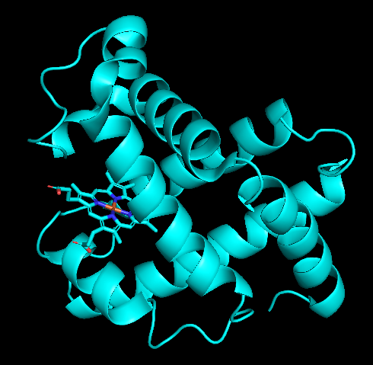
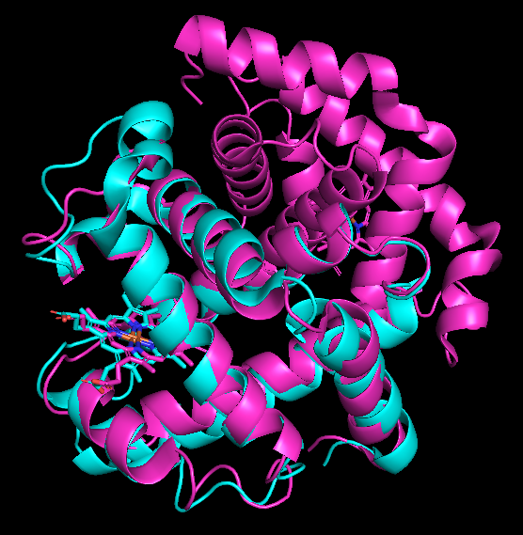
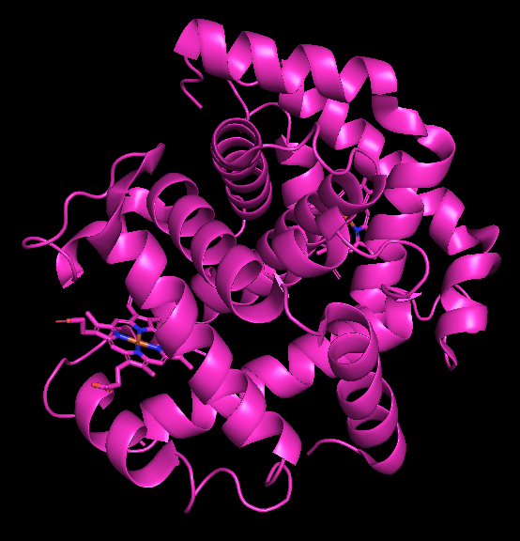
WHY SEQUENCE ALONE ISN'T ENOUGH
A WORKED EXAMPLE · WHY STRUCTURE MATTERS MORE THAN SEQUENCE
Same shape, different letters — and the model knows it.
Two proteins can share only a quarter of their amino-acid letters and still fold into nearly identical 3D shapes. To a sequence-only splitter, they look like strangers. To the model, they look like siblings.
// PROTEIN A · CYAN
// THE TWO STRUCTURES, OVERLAID
// PROTEIN B · MAGENTA
Myoglobin
Hemoglobin α-chain
Stores oxygen in muscle. Single heme group.
sequence identity: ~25% · RMSD: < 2 Å
Carries oxygen in red blood cells. Same fold, different gene.
A quarter of the letters match. The shape is essentially identical.
PDB · 1MBO · 153 aa
PDB · 1HHO · 141 aa
⚠
Sequence-only splits miss this. Two proteins at ~25% identity look like strangers to a BLAST-style check. Train on myoglobin and test on hemoglobin and the leakage audit says "no overlap" — but the model sees the same fold and the same heme pocket, so its prediction is half-cheating.
✓
ProteoSphere groups them anyway. The splitter pools sequence similarity, structural similarity, and binding-pocket geometry. Same-fold proteins get held out together. Honest scores survive contact with reality.
Structures: myoglobin (1MBO) · hemoglobin α-chain (1HHO). Kendrew JC et al., Nature 181, 662 (1958); Perutz MF et al., Nature 185, 416 (1960) — the first two protein crystal structures, showing how distantly related proteins can share an identical fold.

Slide 6
MODEL STUDIO
THE STUDIO · WHAT WE'LL TOUR
A guided pipeline, one screen at a time.
Every screen has one job. A bench scientist can walk from raw data to a finished, deployable model without ever opening a terminal.
01
02
03
04
05
Reference Library
Dataset Designer
Splitter
Pipeline Builder
Train & Review
What's in our universe of proteins and molecules
Pick which examples to train on
Leakage-aware splits — the heart of the platform
Visual ML architecture, no code
Live training and honest metrics

Slide 7
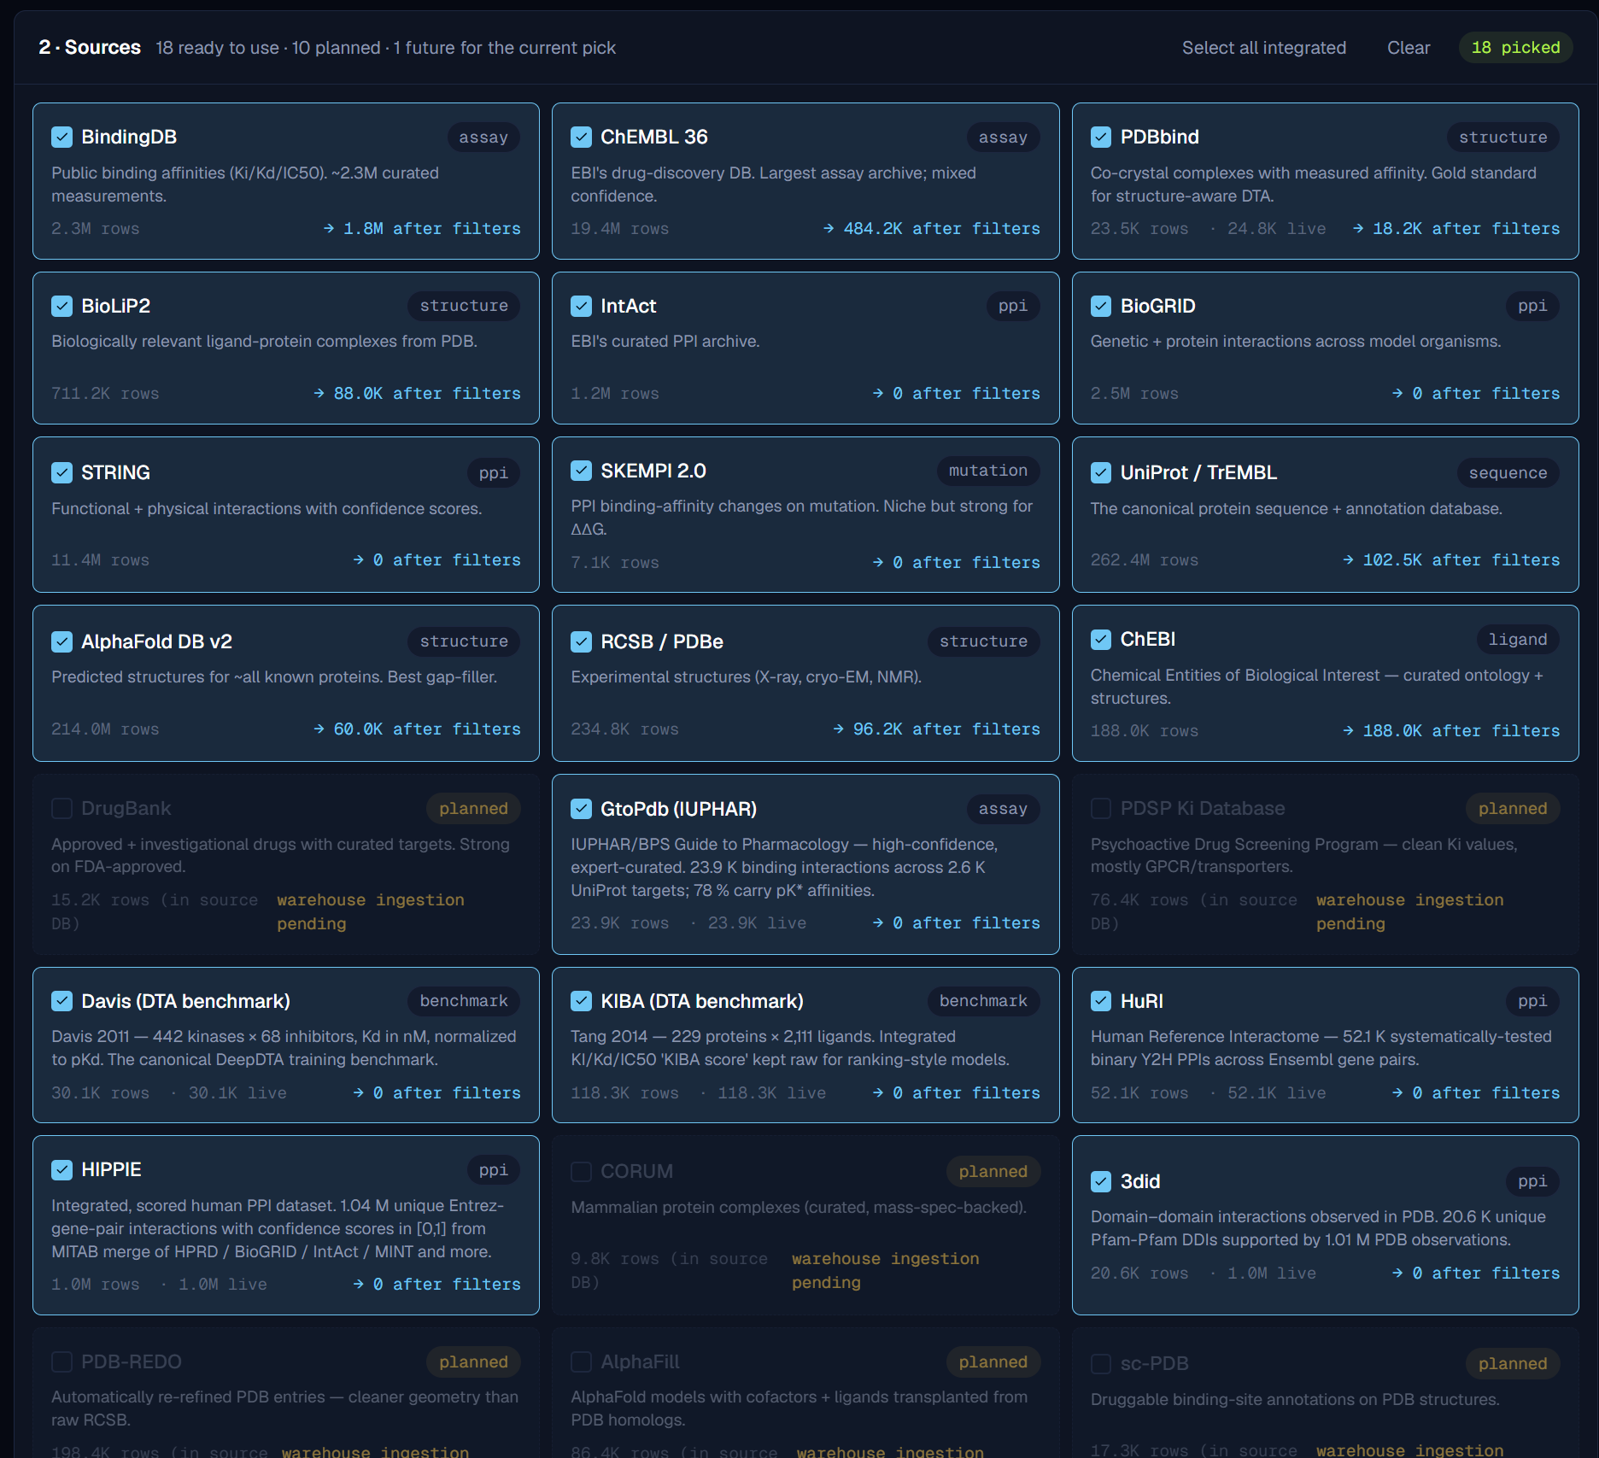
MODEL STUDIO
01 · REFERENCE LIBRARY
The warehouse of known biology.
Before any model is trained, ProteoSphere ingests, cleans, and unifies every major public source of protein, drug, and binding data into a single searchable warehouse.
UniProt · PDB · ChEMBL · BindingDB · IntAct · Reactome · AlphaFold DB · InterPro, and more. 262 million proteins, 234,000 experimental structures, 24,800 curated binding assays — all pre-clustered for safe splits.
i
Every record carries its source, version, and content hash — so months later you can prove exactly what data trained which model.

Slide 8
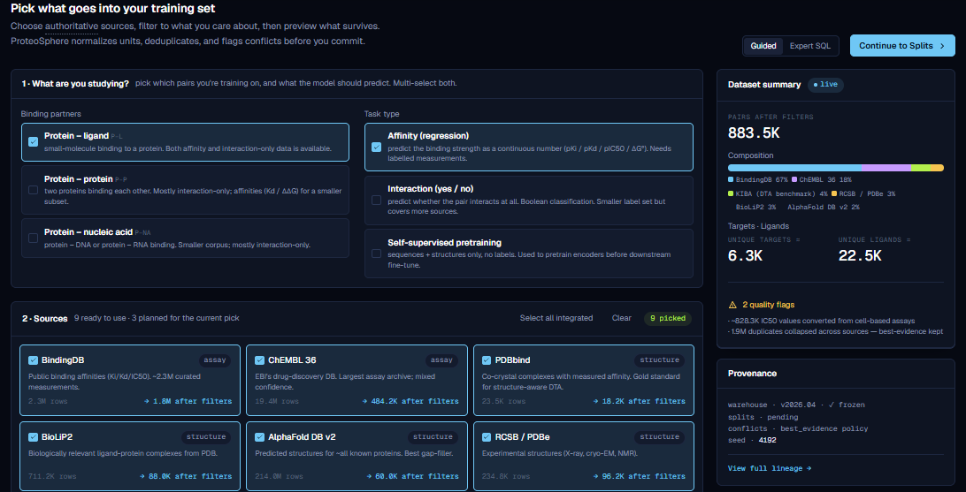
MODEL STUDIO
02 · DATASET DESIGNER
Choose what to train on.
Plain-language picks for what kind of binding you're modelling, the data sources to draw from, and the quality filters to apply. A live dataset-summary rail on the right keeps the count, composition, and provenance visible as you tick boxes.

Slide 9
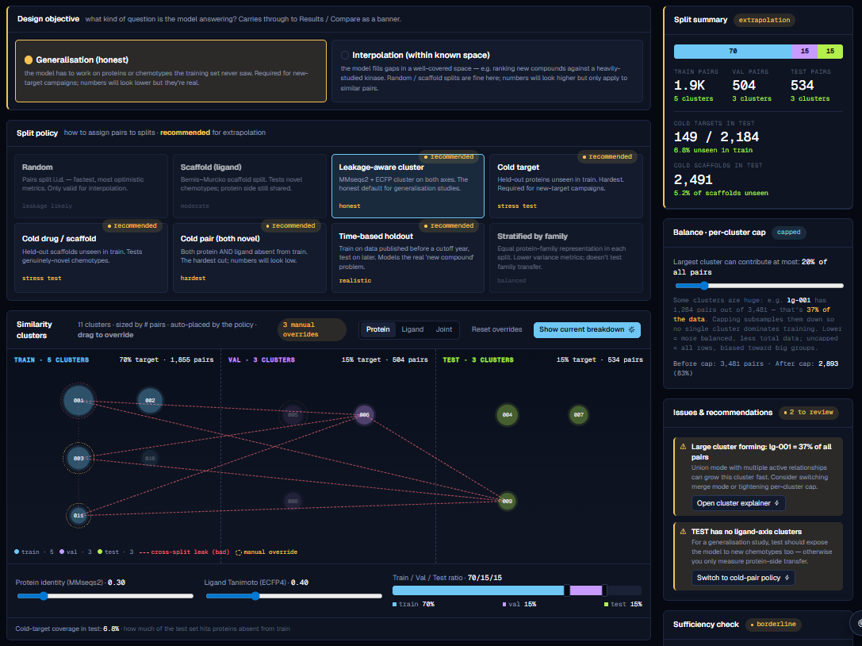
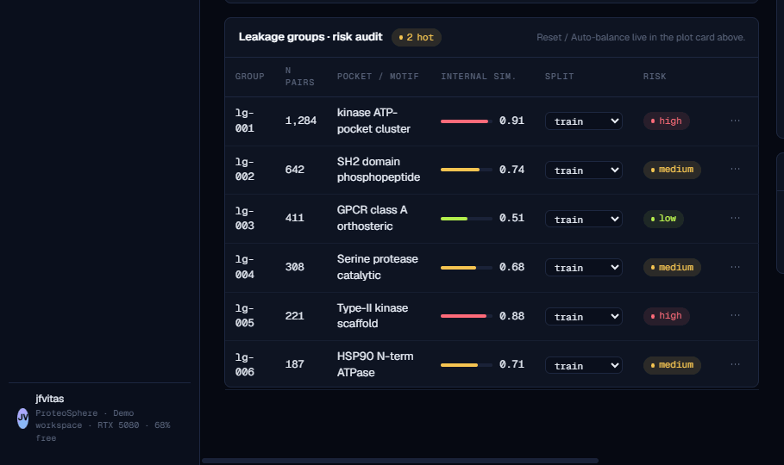
MODEL STUDIO
03 · THE SPLITTER · THE MOST IMPORTANT SCREEN IN THE PLATFORM
Pick how to hold out the test set.
Eight policies, ranked by honesty. Random is marked leakage likely ; leakage-aware cluster is the default for any study you intend to publish or promote. Choose the design objective and the policy, and the cluster diagram below redraws live.

Slide 10
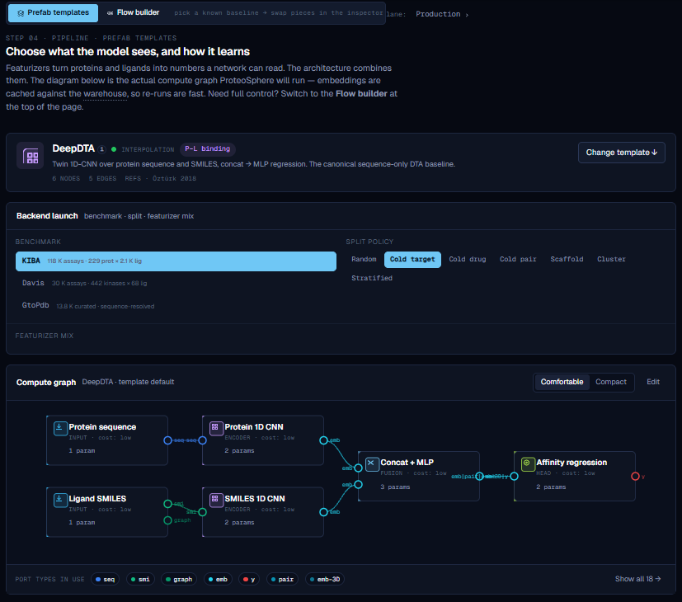
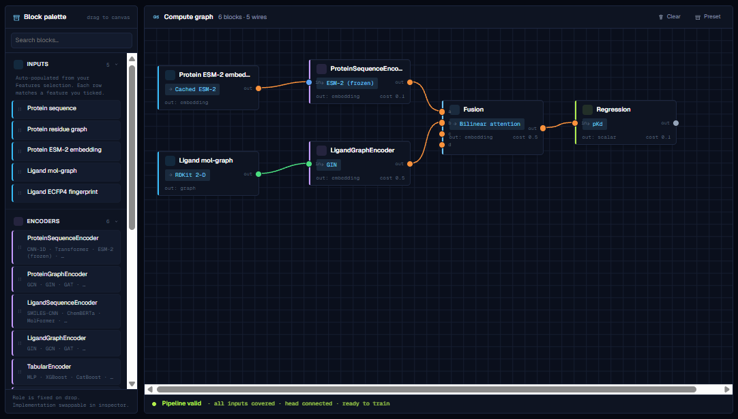
MODEL STUDIO
04 · PIPELINE BUILDER
Compose the model — prefab or custom.
Two modes: load a prefab template (DeepDTA, ConPLex, DrugBAN…) for a known-good architecture, or open the flow builder and wire encoders, fusion, and prediction heads together yourself. Ports are color-coded; mismatched wires are refused on contact.

Slide 11
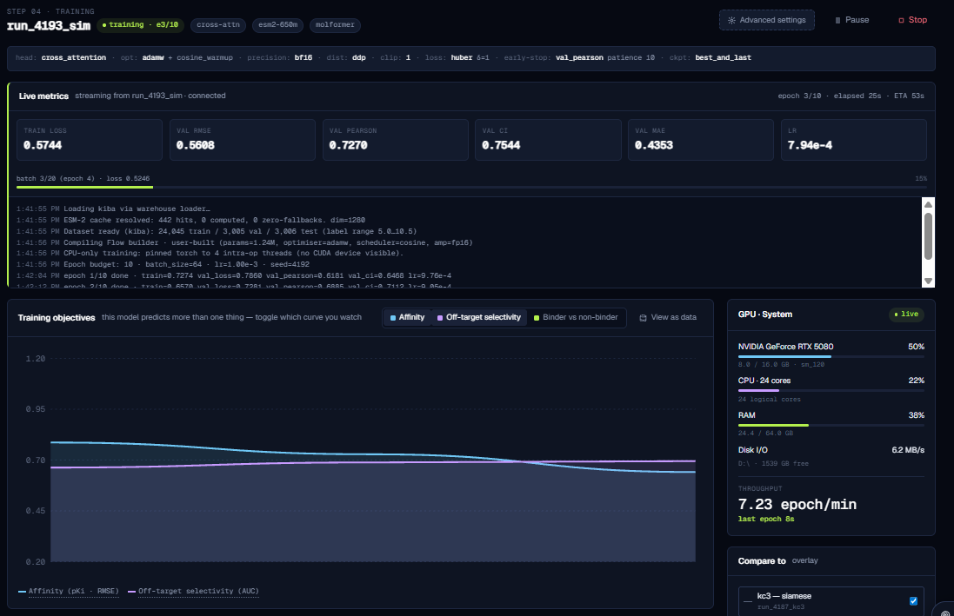
MODEL STUDIO
05A · LIVE TRAINING MONITOR
Watch the model learn — live.
Streaming loss, validation metrics, GPU utilization, and per-block diagnostics. Multi-objective curves in one chart; pattern-detector insights surface inline as the run progresses.

Slide 12
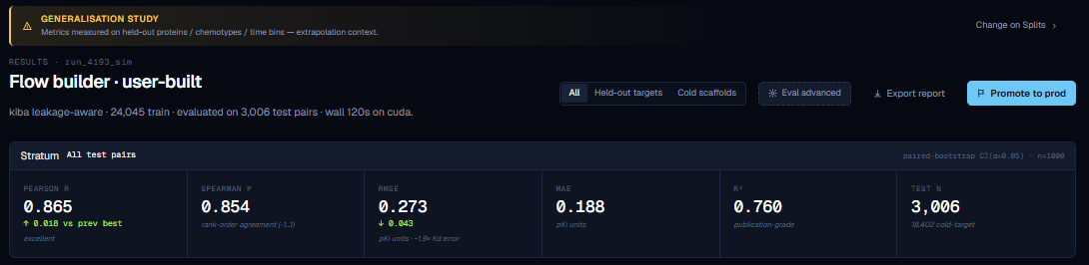
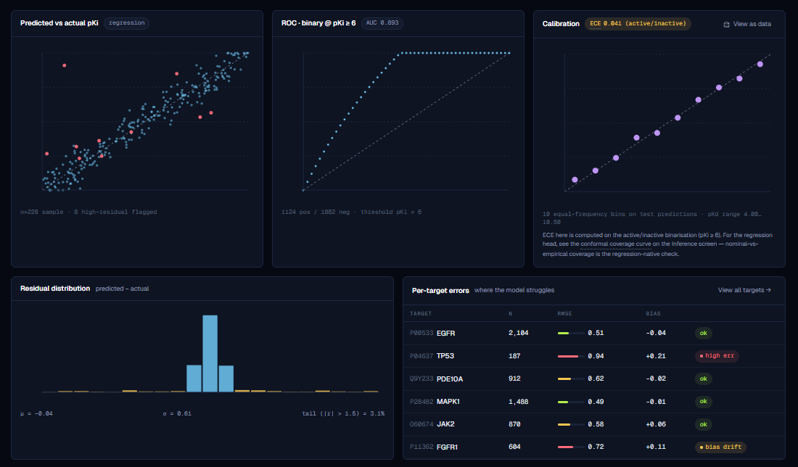
MODEL STUDIO
05B · RESULTS · THE REAL DELIVERABLE
Honest metrics, broken down.
Pearson, Spearman, RMSE, R² on the held-out pairs — plus prediction-vs-actual scatter, ROC at the activity threshold, calibration, residual distribution, and per-target error rows.

Slide 13
BY THE NUMBERS
BY THE NUMBERS
What's actually inside.
A snapshot of the scope behind the screens you just saw.
PROTEINS INDEXED
ANNOTATIONS
MODEL CATALOG
BUILT SOLO, IN
262M
22M
152
~6 mo
UniProt-grounded, with family + taxonomy
Motifs, domains & pathway roles
Encoders, fusions, and prediction heads
One semester · specs, code, UI, validation
DATA SOURCES UNIFIED
AUDIT CHECKS PER DATASET
LINES OF CODE
NETWORK CALLS REQUIRED
11
5
~100k
0*
UniProt, PDB, ChEMBL, BindingDB, IntAct…
Sequence, chemistry, motif, structure, pathway
Python · TypeScript · SQL · CSS
Runs fully offline on the local warehouse
*Options planned for building features from structure files to be downloaded and purged automatically

Slide 14
THANK YOU
Better medicines start with more honest models.
ProteoSphere is one student's attempt to push that idea forward, end to end, in software you can actually use.
// WHAT I LEARNED
// WHAT'S NEXT
// WHY MEDICINE
Building a tool for non-experts forces you to deeply understand why each scientific decision matters — not just how to make it.
A wet-lab feedback loop, so a model's real-world predictions measurably improve the next version of itself.
Computation is a powerful tool. But it only helps patients when doctors and biologists can trust, question, and use it.
Jon
·
ProteoSphere
·
2026

